Slide 1
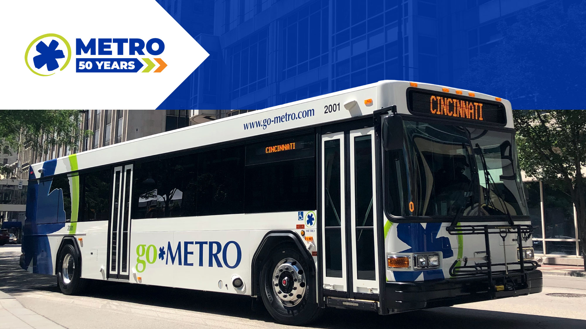
September 2023 Ridership Report
October 17, 2023 | Matt Moorman

Slide 2

Fixed-Route Ridership

Slide 3


Slide 6
*percentage points

Slide 7
*percentage points

Slide 8
Overall: 72.0%

Slide 12


Slide 15
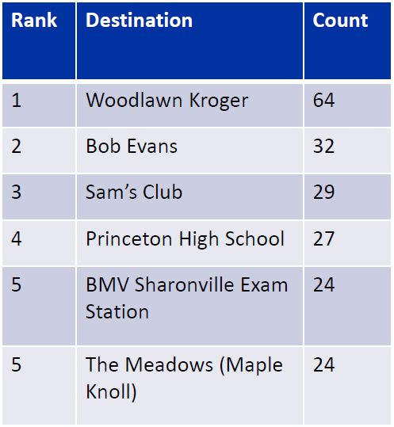
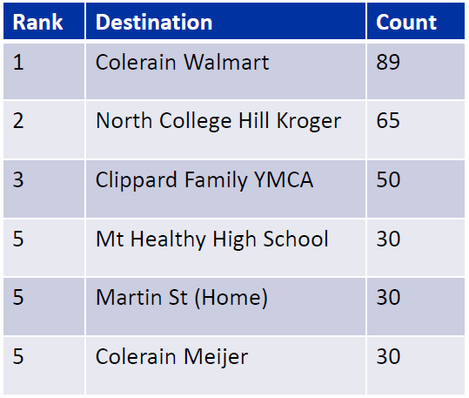
Springdale Zone Most Visited Locations
Northgate Zone Most Visited Locations

Slide 16
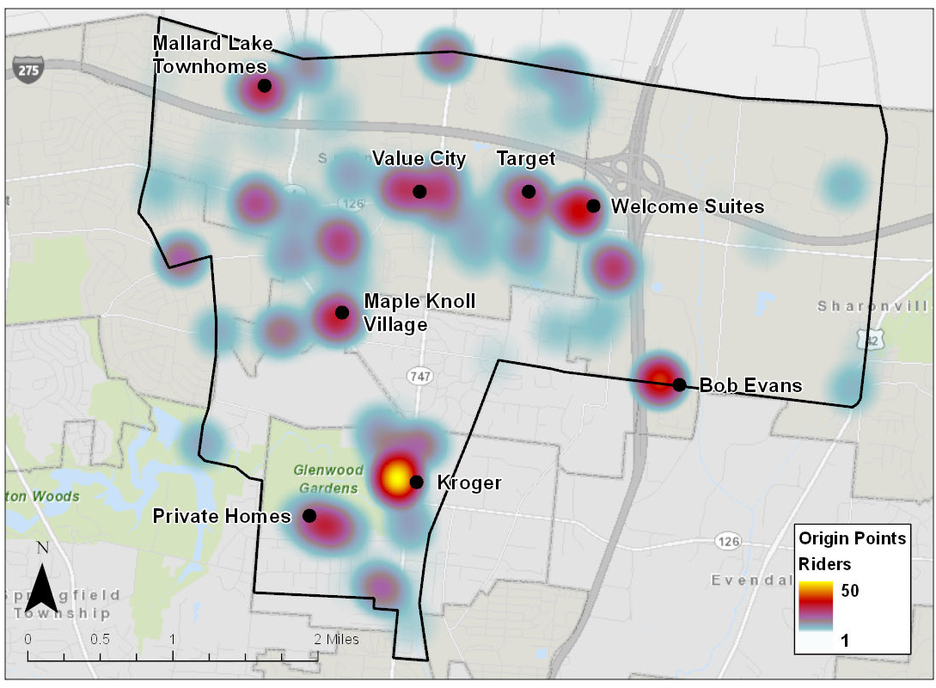
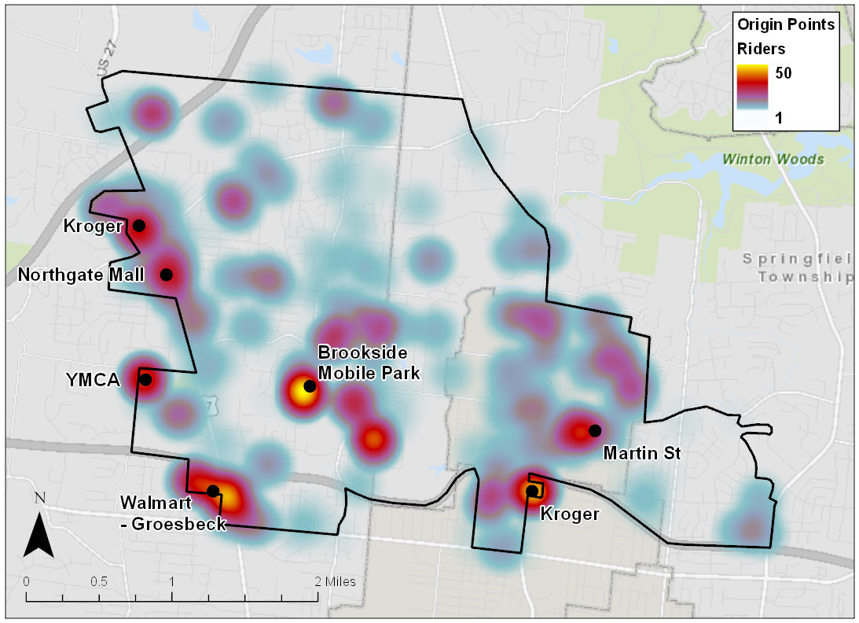
Springdale Zone Usage Map
Northgate Zone Usage Map

Slide 17

ACCESS Ridership

Slide 20
OTP: 87.8%

Slide 21
*percentage points

Slide 22

Route Level KPIs

