Slide 1
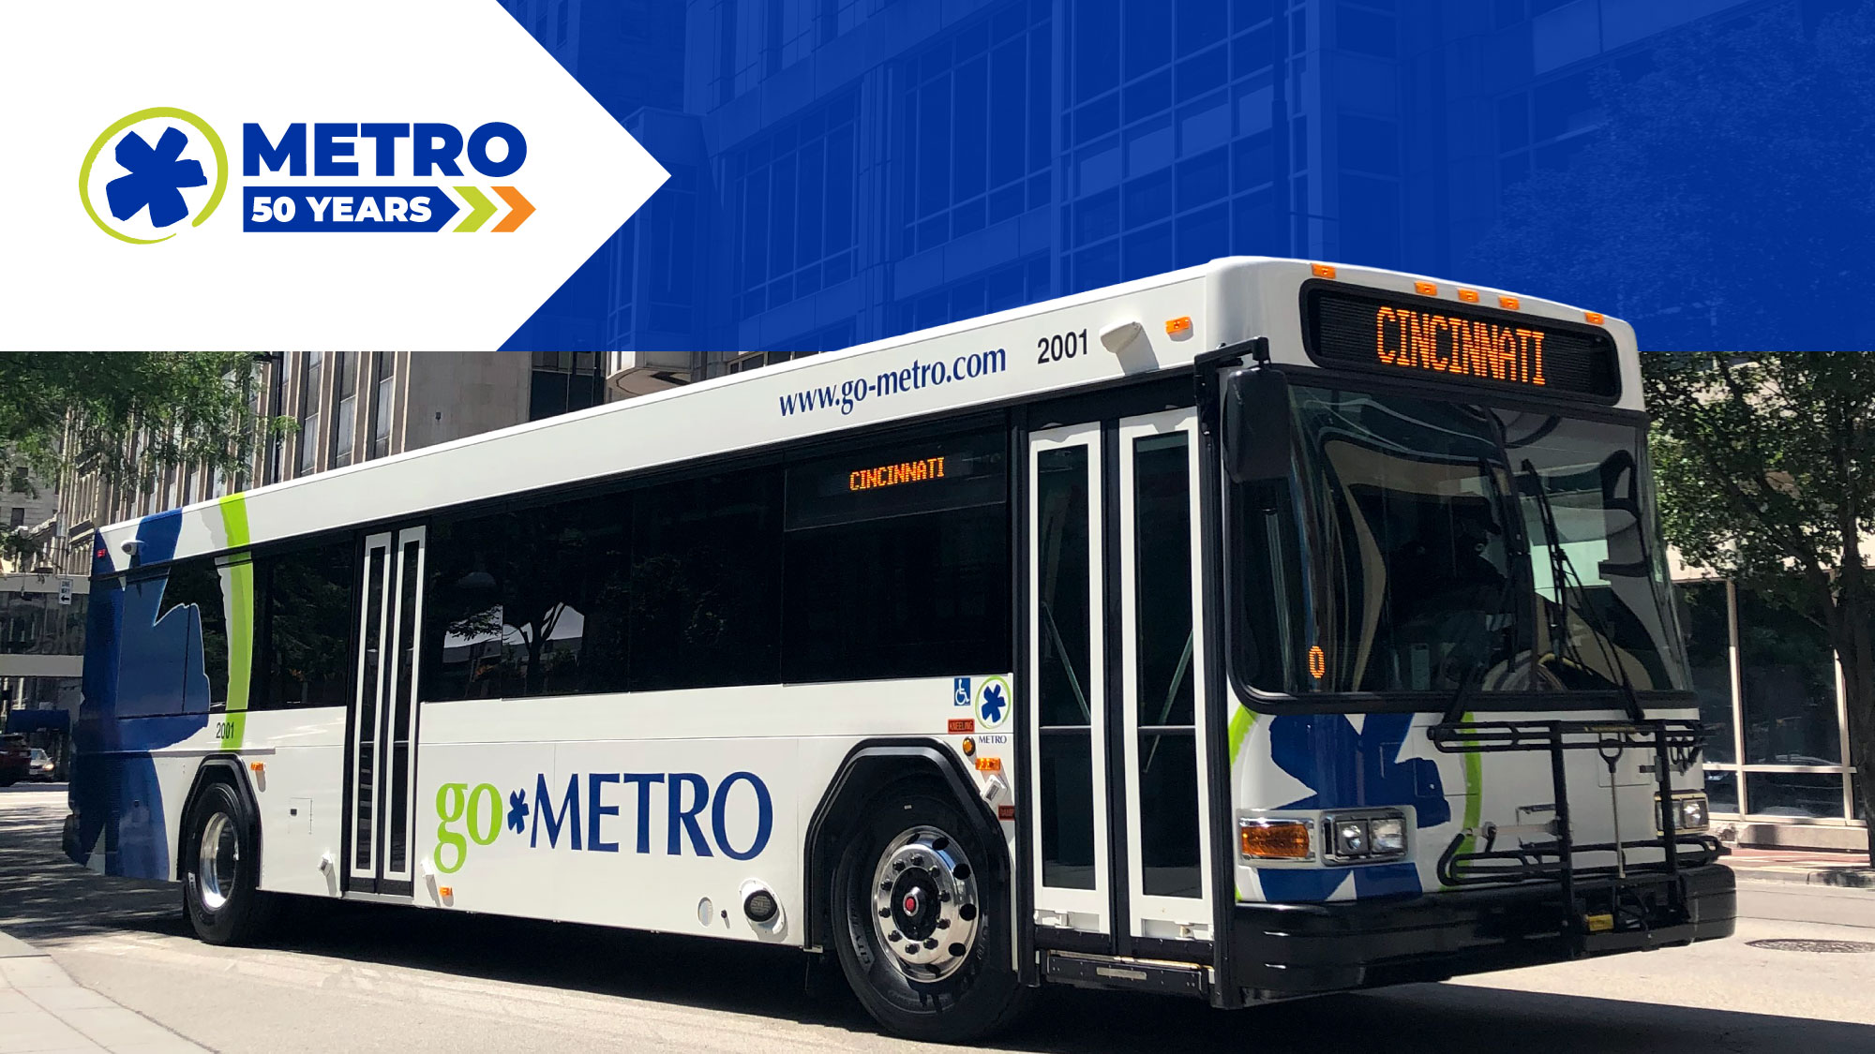
December 2023 Ridership Report
January 16, 2024 | Matt Moorman

Slide 2

Fixed-Route Ridership

Slide 3


Slide 6
*percentage points

Slide 7
*percentage points

Slide 8
OTP: 76.7%

Slide 12
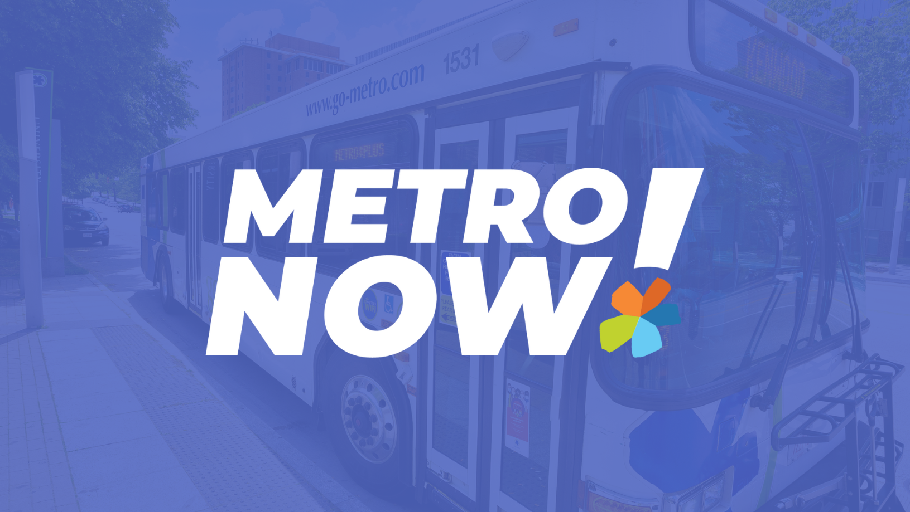

Slide 15

ACCESS Ridership

Slide 18
OTP: 89.7%

Slide 19
*percentage points

Slide 20

Route Level KPIs

