Slide 1
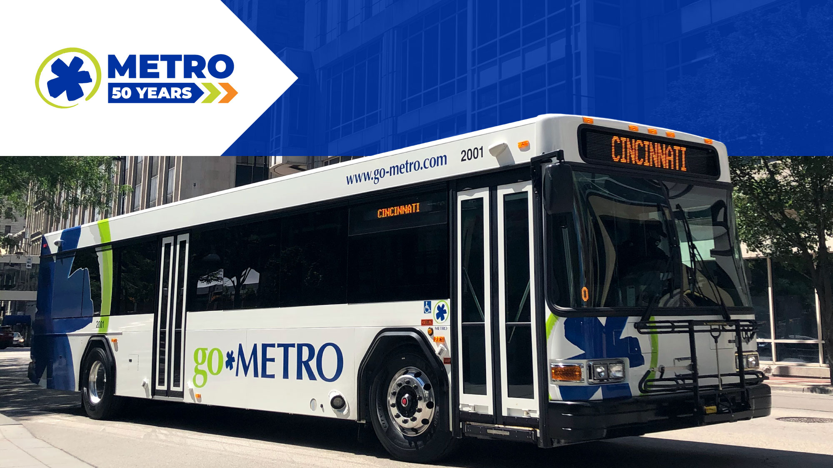
May 2023 Ridership Report
June 20, 2023 | Steve Anderson

Slide 2

Fixed-Route Ridership

Slide 3


Slide 6
*percentage points

Slide 7
*percentage points

Slide 8
Overall: 77.3%

Slide 12

ACCESS & MetroNow Ridership

Slide 15
OTP: 89.7%

Slide 16
*percentage points

Slide 17
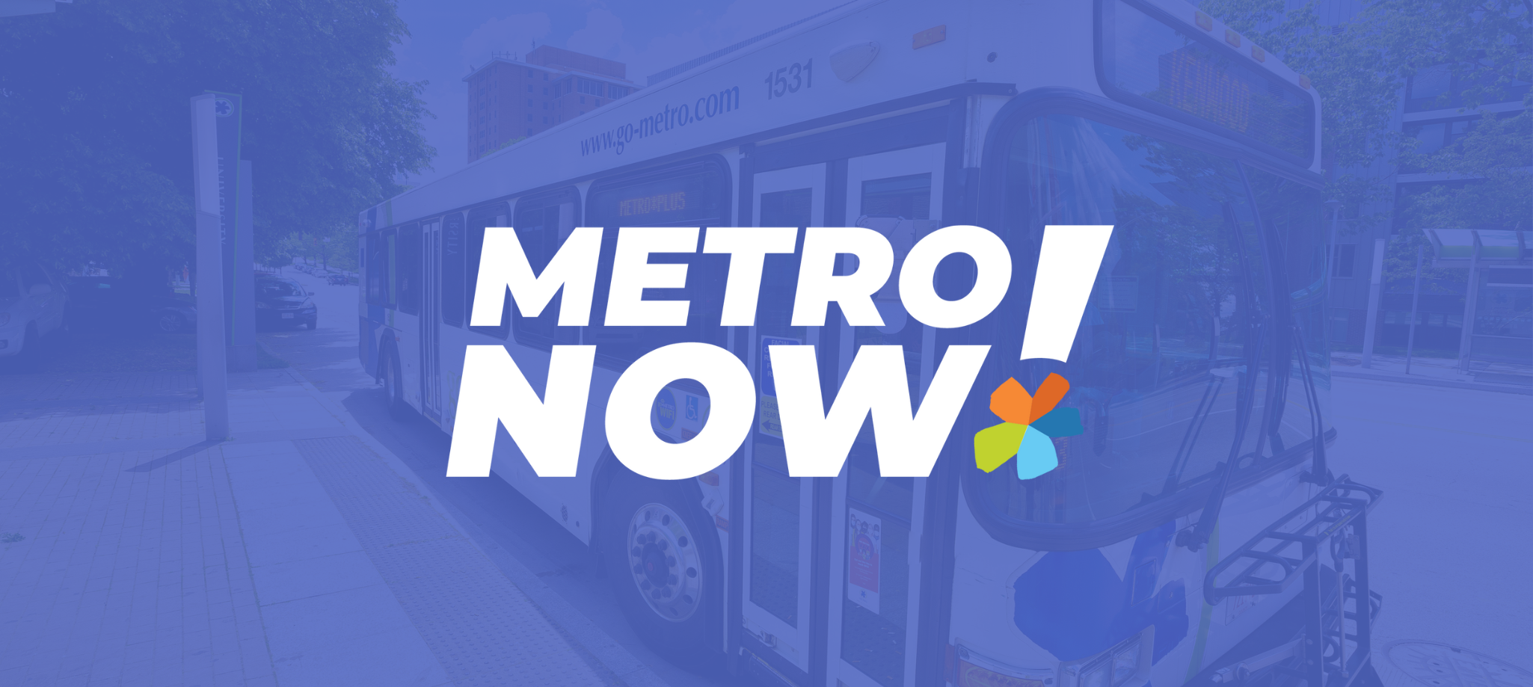

Slide 18

Route Level KPIs

