Slide 1
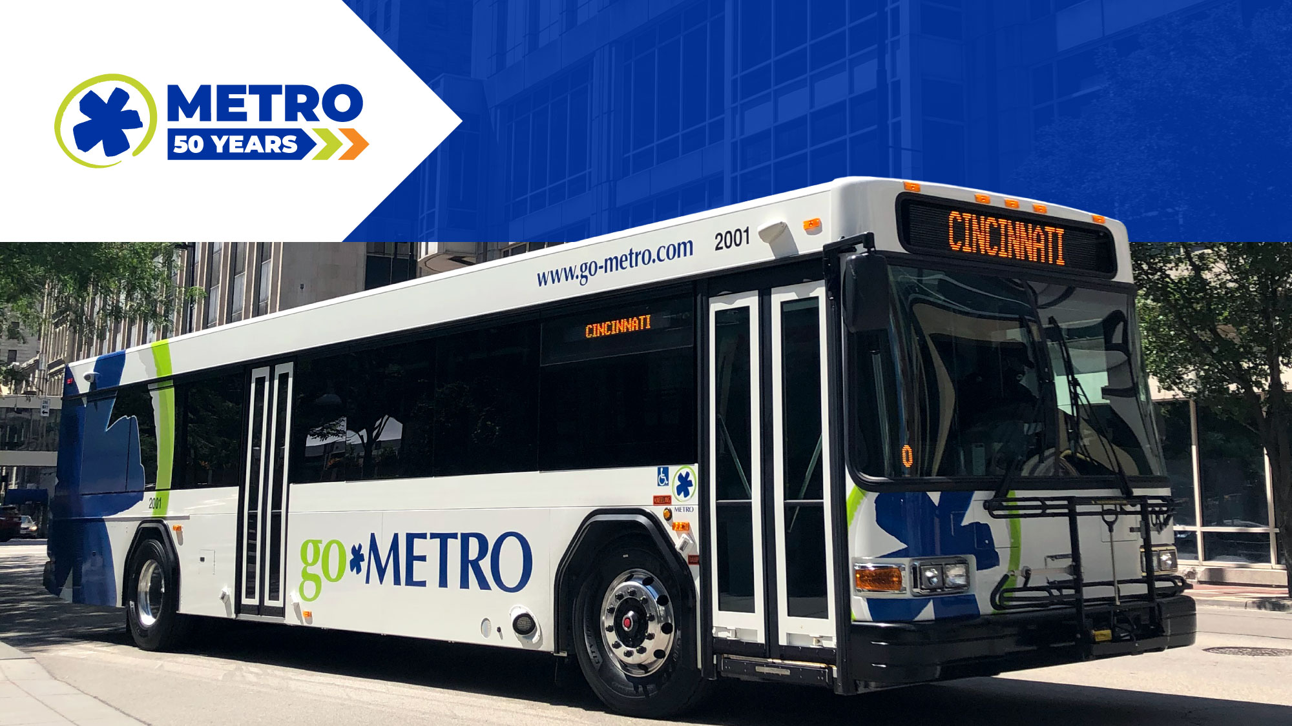
March 2023 Ridership Report
April 18, 2023 | Matt Moorman

Slide 2

Fixed-Route Ridership

Slide 3


Slide 6
*percentage points

Slide 7
*percentage points

Slide 8
Overall: 80.8%

Slide 12

ACCESS Ridership

Slide 15
OTP: 91.0%

Slide 16
*percentage points

Slide 17

Route Level KPIs

