Slide 1
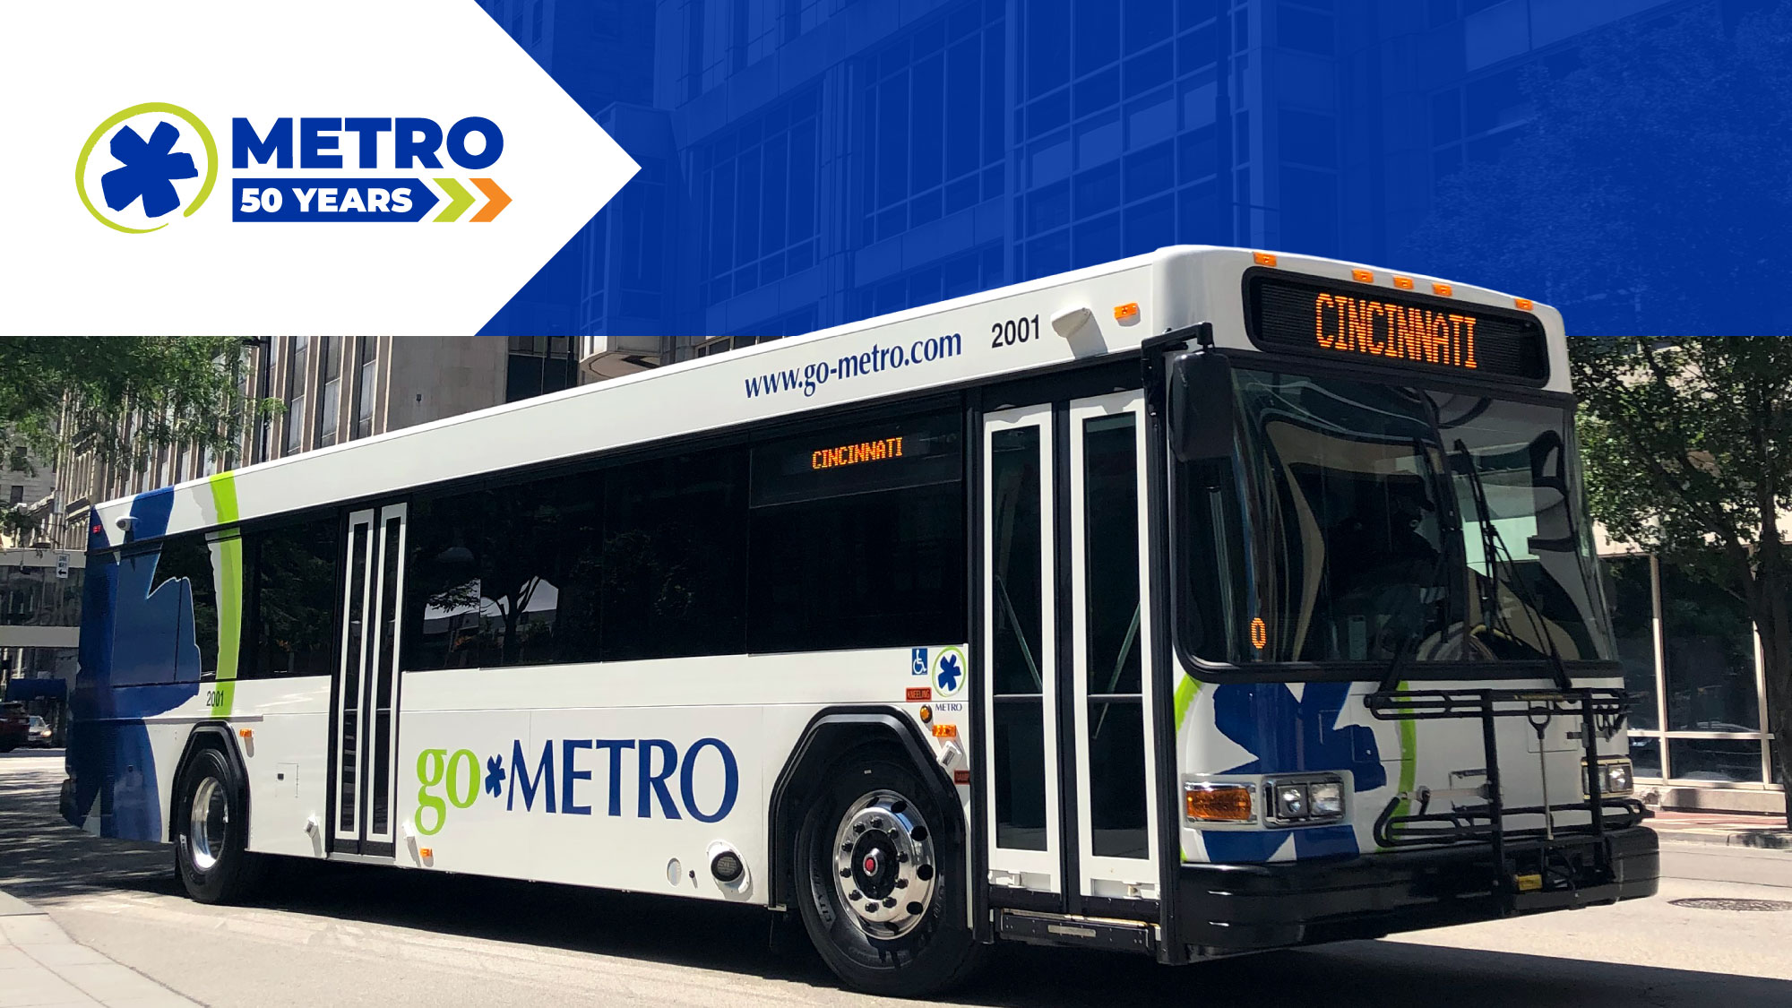
June 2023 Ridership Report
July 18, 2023 | Matt Moorman

Slide 2

Fixed-Route Ridership

Slide 3


Slide 6
*percentage points

Slide 7
*percentage points

Slide 8
Overall: 77.5%

Slide 12

ACCESS & MetroNow Ridership

Slide 15
OTP: 89.8%

Slide 16
*percentage points

Slide 17
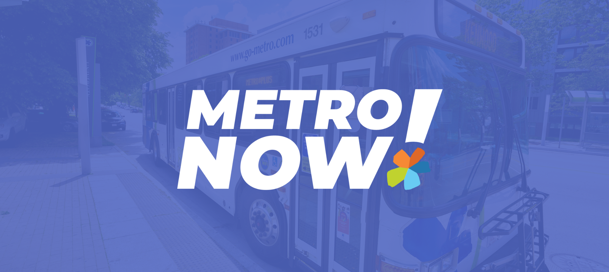

Slide 18

Route Level KPIs

